Slide 1
Corporate QE
2012 Audit Planning/Scheduling
Jan 9-13, 2012
Prepared by
Denise Echols

Slide 2
2012 Audit Planning/Scheduling
All sites to be audited; many changes/additions (process, pilots, tools, scope expansion & staff)
2-3 auditors for some site audits or initial audits
  Start Lab Scope Reviews currently (LTL, LSI)
    Will end when/if other technical review starts
  Increase in number programs, tools, etc
  Labs (PV)added; scope expansions
Group audit location visits to reduce travel
Utilize Web/Desk for sites in combination with Site-Audit when possible
Lunch should be on-site cafeteria or box lunch
Constraints on rescheduling
    Nothing after 1st week of Dec

Slide 3
2012 Audit Planning/Scheduling
Lead Auditor Assignments
  * Primary Regional Audit Management Responsibility (includes programs)
    EULA- Kai (also support some Asia, & NA audits)
    Asia – Jim C. ( also support some NA audits)
    NA – Alan (also support RFI Audit)
    NA – Tovia (some NA Programs
    Auditor Training – Tovia ( also support Demko Audit)
    Primary Process/Program/Business Unit Responsibility
    Manage DAP SNAP- Alan (all auditors support)
    Medical Management System – Julie (Mel , Michelle support)
    Some NBK Programs/Processes – Mark
    Field Services/FUS – Various
  Auditors in Training
    Support will be within your region/site managed
      Constraint OSHA DAP SNAP –Auditor must be from NRTL
        Jim O-No issue-NBK
        Jenni – No Issue – San Jose
        Jim K – No Issue-RTP
        Karen – No Issue- Melville

Slide 4
2012 Audit Planning/Scheduling
Stakeholder inputs
  Lead Auditors review info for 2012 scopes; past audit notes
Document changes requiring audits
  Many Policy & SOP Changes
Incorporating Site Accreditations(A2LA, IAS, etc)
    Include in scope/agenda of audits
    Path notes to annotate A2LA, Energy Star, etc (top of page)
Auditor and CAR Adm role combined- IQA findings only
  All Locations, all IQA audits

Slide 5
2012 Audit Planning/Scheduling
Scope of audits to include:
  Corrective/Preventive Action
    Review CAR Metrics
  Customer Complaints (program, process, site)
  Document Control
  Human Resource Requirements
    Conflict of interest/Confidentiality (site and program)
  Legal Entity (site)
  Records Requirements
  Management Review ( required only at program and lab level)

Slide 6
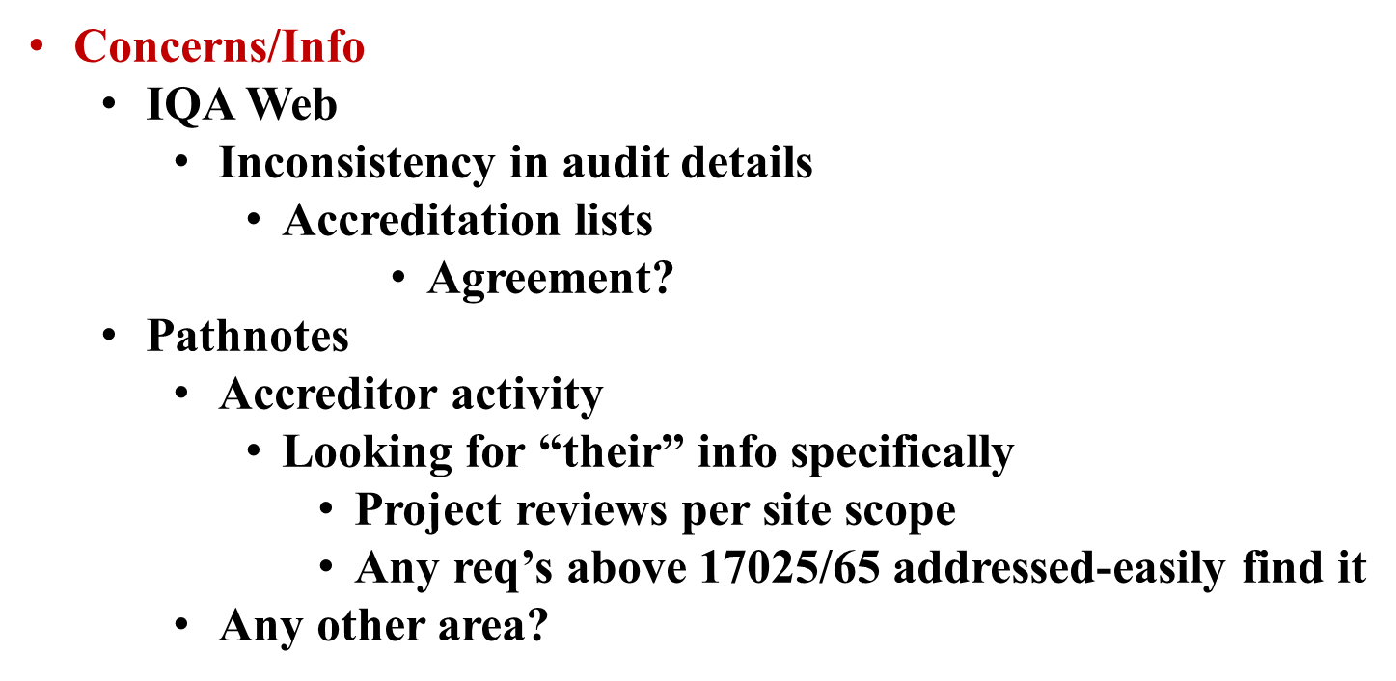
2012 Audit Planning/Scheduling

Slide 7
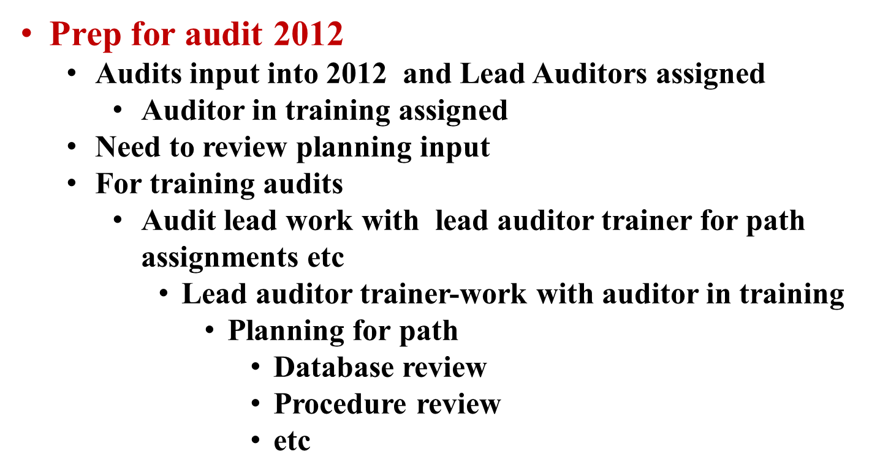
2012 Audit Planning/Scheduling

